Slide 1
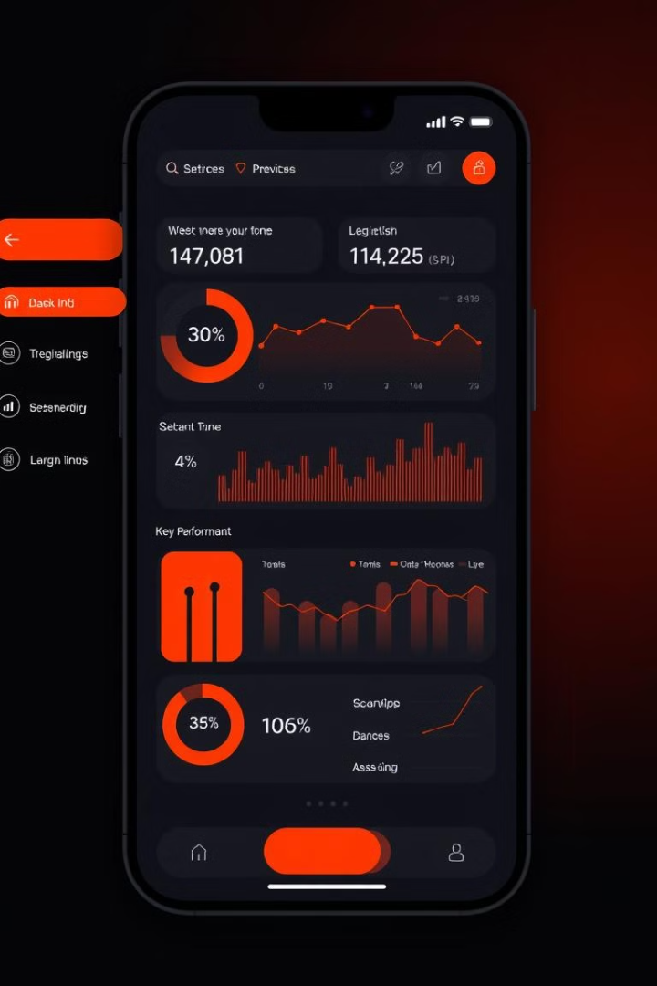
Multilingual Budget & Expenses Tracker
This presentation outlines a versatile and user-friendly budgeting and expense tracking solution that empowers users across language barriers to manage their finances effectively.
Group Members
Ehtijad Ali Shah
Sartaj Ali
Almeen
Saqlain Nissa
Badar Muneem

Slide 2
Organize Expenses Across Categories
Flexible Categorization
Intuitive Tracking
Users can categorize expenses by creating customized categories aligned with their personal financial needs.
Effortlessly track every expense, from groceries to travel, for clear financial visibility.

Slide 3
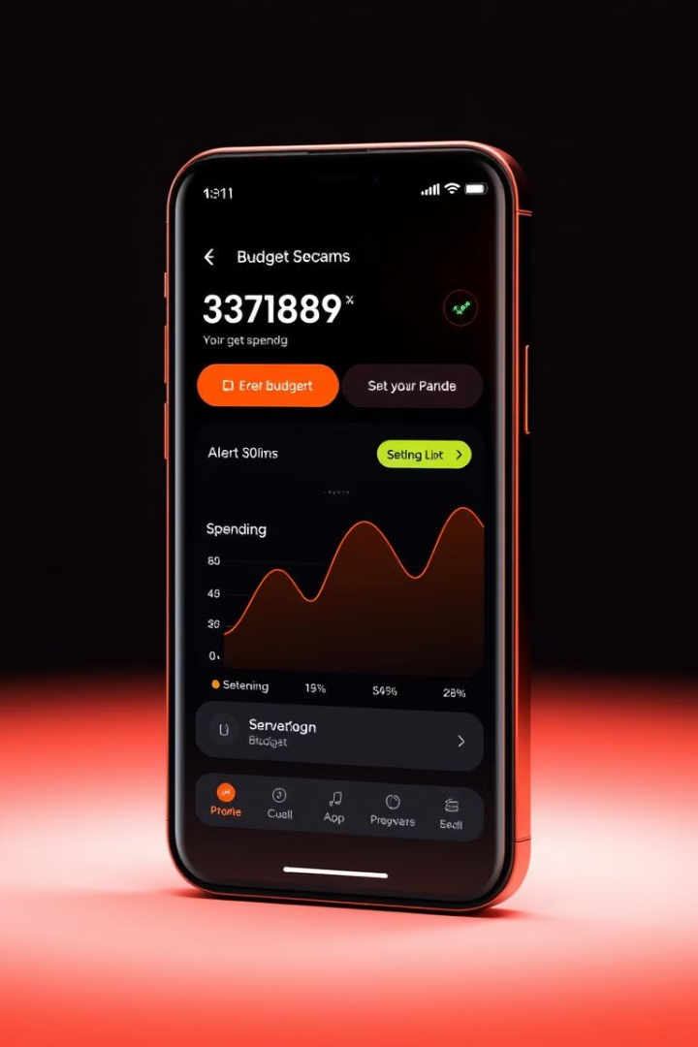
Set Budgets and Receive Alerts
Set Budget Limits
Real-Time Alerts
Establish clear financial goals by setting budgets for each category based on individual needs.
Receive instant notifications when approaching or exceeding budget limits, promoting responsible spending.

Slide 4
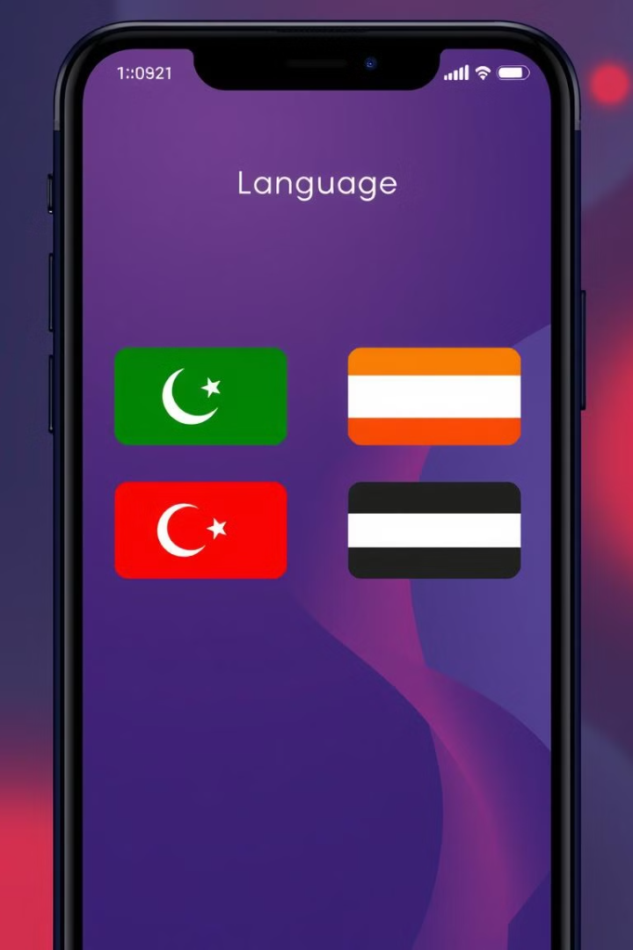




Multilingual Support
Urdu
Arabic
The app seamlessly supports Urdu, ensuring effortless user experience for our diverse user base.
The app also supports Arabic, providing accessible financial management tools for a wider audience.
Hindi
English
Users can effortlessly switch to Hindi for a more familiar and personalized experience.
The app naturally includes English language support, catering to global users.

Slide 5
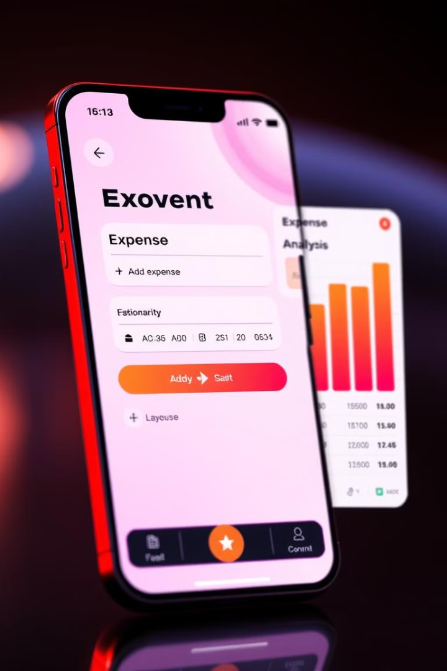
Expense Addition and Analysis
1
Easy Expense Entry
Effortlessly add expenses with clear descriptions, dates, and categories for accurate tracking.
2
Automated Analysis
The app automatically analyzes spending patterns, providing valuable insights into financial habits.

Slide 6



Visualizing Financial Insights
Comprehensive Overview
1
Category Breakdown
2
Visualize expenses by category, revealing spending patterns and areas for improvement.
Trend Analysis
3
Track spending over time, identifying patterns and potential areas of concern.

Slide 7
Detailed Expense Insights
Drill Down
1
Users can delve deeper into specific expenses with detailed breakdowns and transaction histories.
Filter Options
2
Refine expense analysis using filters based on category, date range, and amount.
Personalized Reports
3
Generate customized reports for detailed financial analysis, providing actionable insights.

Slide 8
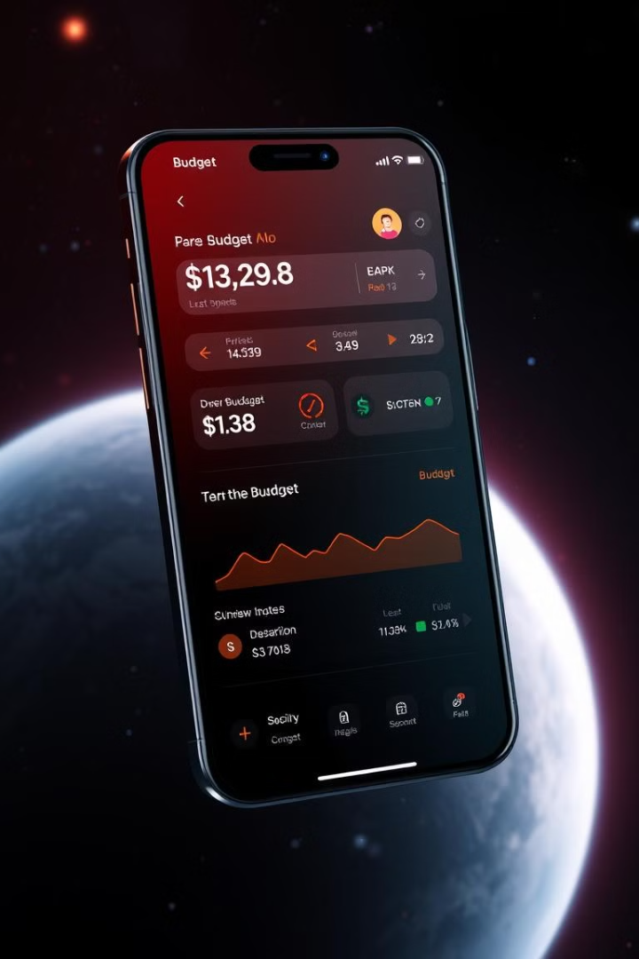
Real-Time Budget Monitoring
100%
Budget Awareness
Track budget progress in real-time, ensuring informed financial decisions.

Slide 9



Conclusion: Empowering Financial Control
Simplified Budgeting
Global Reach
Data-Driven Insights
The app streamlines financial management, making it easier to stay on budget.
With multiple language support, the app caters to diverse users worldwide.
Comprehensive data visualizations provide actionable insights to optimize finances.

